Slide 1
TITLE
A Proactive stress management Framework using behavioral and lifestyle Analytics
TeamA9: P.Samatha(23UP1A0550) D.Swarani(23UP1A0515) C.Nimitha(23UP1A0514) G.Pavani (23UP1A0521)
Guided by:
Mrs.Ch.Vijaya Jyothi
Asst professor of CSE dept

Slide 2
ABSTRACT
In recent years, stress has emerged as a critical issue affecting both mental and physical health due to demanding work environments, irregular lifestyles, and increased dependence on digital technology. Most existing stress management systems are reactive in nature, focusing on treatment only after stress symptoms become severe. This project presents a Proactive Stress Management Framework using Behavioral and Lifestyle Analytics that aims to detect early indicators of stress and support preventive intervention. The proposed framework collects and analyzes behavioral data such as sleep patterns, physical activity levels, screen usage, work routines, and self-reported emotional states, along with lifestyle factors including dietary habits and social engagement. Advanced data analytics and machine learning techniques are employed to identify stress patterns, classify stress levels, and predict future stress risks. Based on the analytical outcomes, the system provides personalized recommendations, alerts, and coping strategies to encourage healthier lifestyle adjustments. By promoting early detection and continuous monitoring, the proposed framework helps individuals manage stress proactively, improve overall well-being, and reduce the long-term impact of chronic stress.

Slide 3
INTRODUCTION
Stress has become a significant challenge in modern life due to fast-paced lifestyles, work pressure, and increased use of digital technology. Prolonged stress can negatively affect mental and physical health, leading to reduced productivity and serious health issues if left unmanaged. Therefore, effective stress management has become an important requirement in today’s society.
Most existing stress management methods are reactive, addressing stress only after symptoms become severe. This project proposes a Proactive Stress Management Framework using Behavioral and Lifestyle Analytics to identify early signs of stress and enable preventive action. The framework analyzes behavioral factors such as sleep patterns, physical activity, screen time, and emotional states, along with lifestyle habits like diet and social interaction.
Using data analytics and machine learning techniques, the system detects stress patterns and predicts potential stress risks. Based on the analysis, personalized recommendations and alerts are provided to help users adopt healthier lifestyle practices. This proactive approach supports continuous stress monitoring and helps improve overall well-being while reducing long-term health risks.

Slide 4
LITERATURE SURVEY
S. No | Title/Topic | Author/Source | Key Findings | Reference Links
1 | Detecting Stress During Real-World Driving Tasks | Rosalind W. Picard, Shaun Healey | Demonstrated that stress can be detected using physiological and behavioral indicators with machine learning techniques | https://affect.media.mit.edu/pdfs/05.heal ey-driving.pdf
2 | Stress Recognition Using Wearable Sensors | Akane Sano, Rosalind W. Picard | Identified strong relationships between sleep quality, daily habits, and stress levels using wearable data | https://affect.media.mit.edu/pdfs/13.san o-stress.pdf
3 | Continuous Stress Detection Using a Wrist Device | Hristijan Gjoreski et al. | Achieved continuous stress monitoring using wearable devices and machine learning models | https://ieeexplore.ieee.org/document/747 2708
4 | Predicting Mental Stress Using Behavioral Data | Zhang et al. | Proved that behavioral and lifestyle data such as screen time and work patterns can predict stress early | https://www.sciencedirect.com/science/a rticle/pii/S01650327

Slide 5
EXISTING SYSTEM
The existing system mainly follows a reactive approach to stress management.
Stress is identified only after symptoms become noticeable or severe.
Methods include self-assessment surveys, counseling, and medical consultation.
Limited use of behavioral and lifestyle data for stress analysis.
Some applications track stress using basic inputs but lack continuous monitoring.
Recommendations provided are usually generic and not personalized.
Existing systems do not effectively predict future stress risks.
Less effective in preventing long-term stress-related health issues.

Slide 6
PROPOSED SYSTEM
The proposed system focuses on proactive stress management by identifying stress at an early stage.
It continuously collects behavioral and lifestyle data such as sleep patterns, physical activity, screen time, emotional state, diet, and social interaction.
Data analytics and machine learning techniques are used to analyze patterns and predict stress levels.
The system continuously monitors user behavior to detect early warning signs of stress.
Based on the analysis, personalized recommendations and alerts are provided to help users manage
stress effectively.
This approach helps improve mental well-being, prevent severe stress, and reduce long-term health risks.

Slide 7
SOFTWARE & HARDWARE REQUIREMENTS
Software Requirements :
Hardware Requirements :
Operating System: Windows / Linux / macOS
Programming Language: Python
Development Environment: Jupyter Notebook / VS Code
Libraries & Frameworks:
NumPy
Pandas
Tools: Anaconda Distribution
Database: MySQL / SQLite / MongoDB
Processor: Intel Core i3 or above
Hard Disk: Minimum 20 GB free space
RAM: Minimum 4 GB (8 GB recommended)
Input Devices: Keyboard, Mouse
Optional Devices:
Wearable sensors (smartwatch, fitness band)
Smartphone for data collection

Slide 8
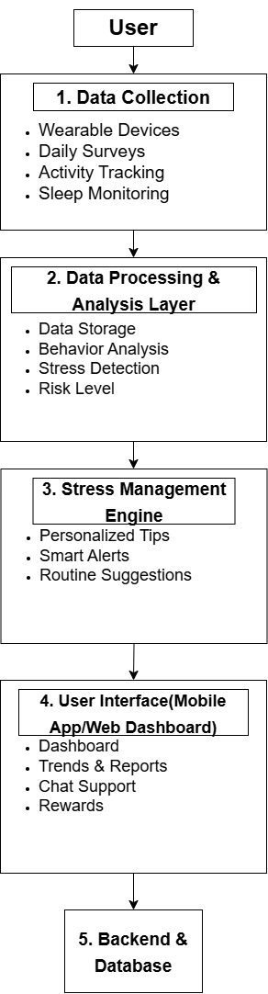
SYSTEM ARCHITECTURE
l

Slide 9
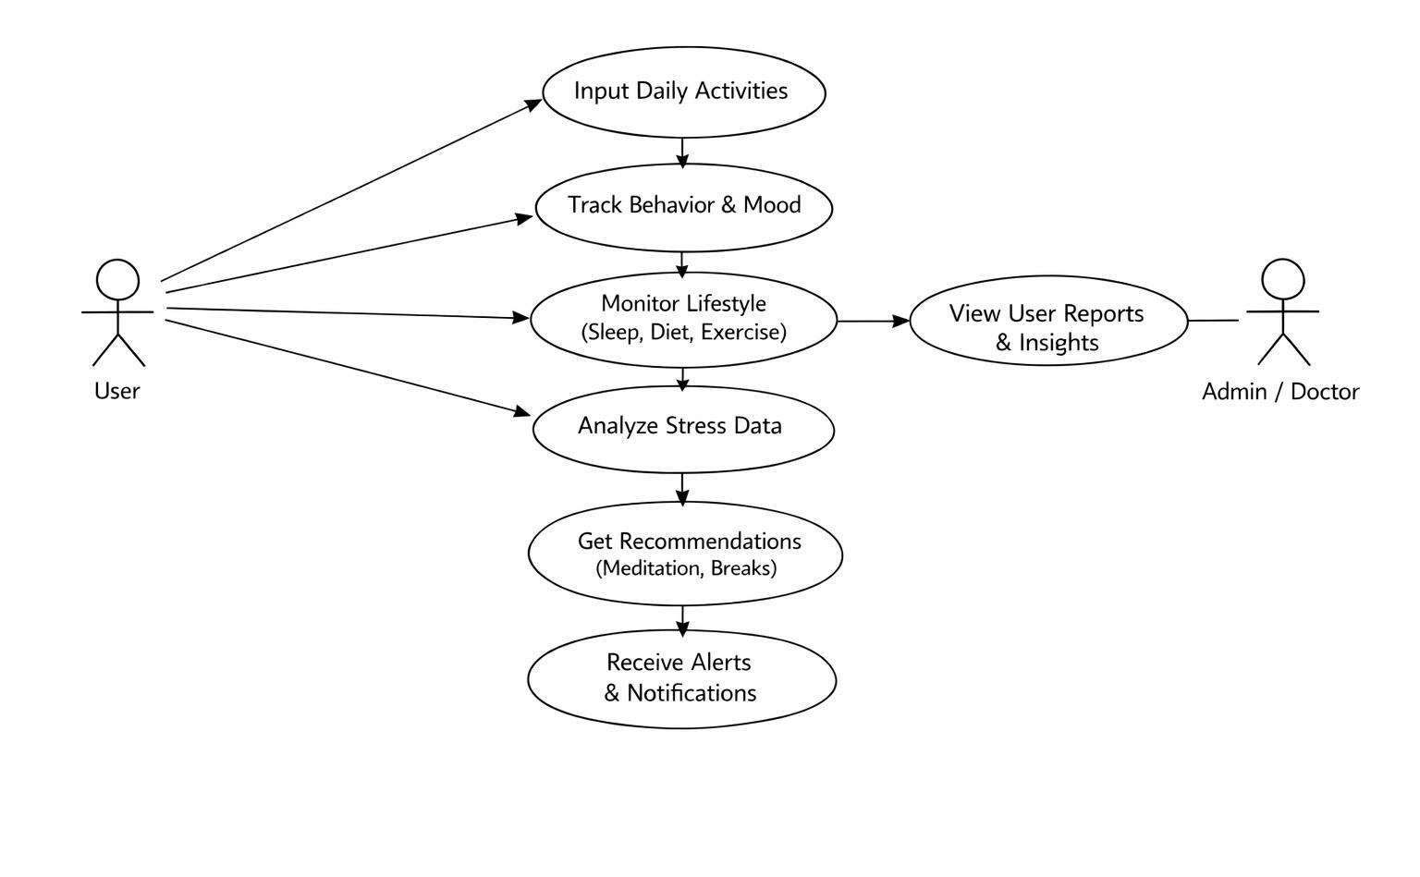
UML Diagrams
USE CASE DIAGRAM:

Slide 10
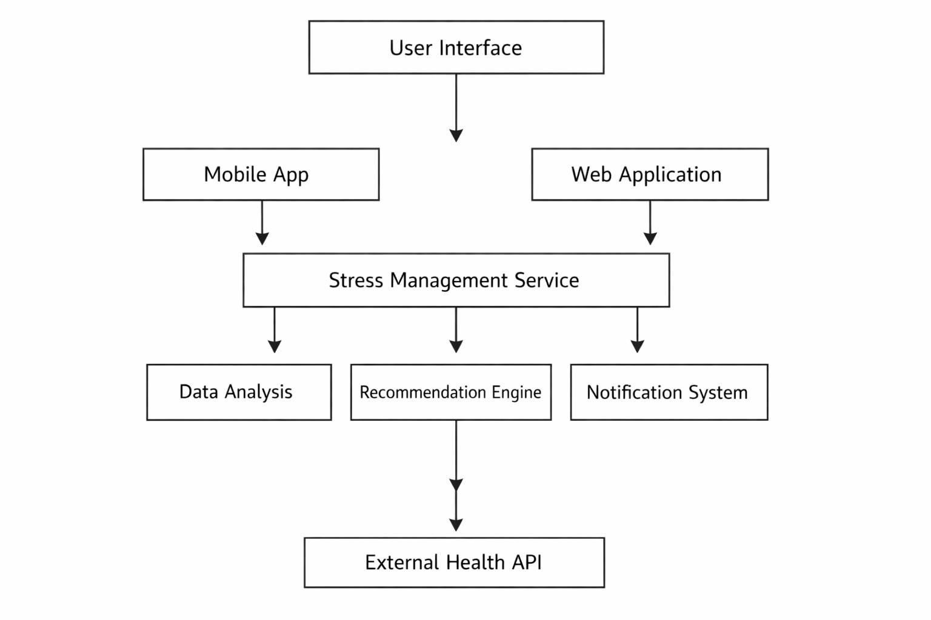
COMPONENT DIAGRAM
1

Slide 11
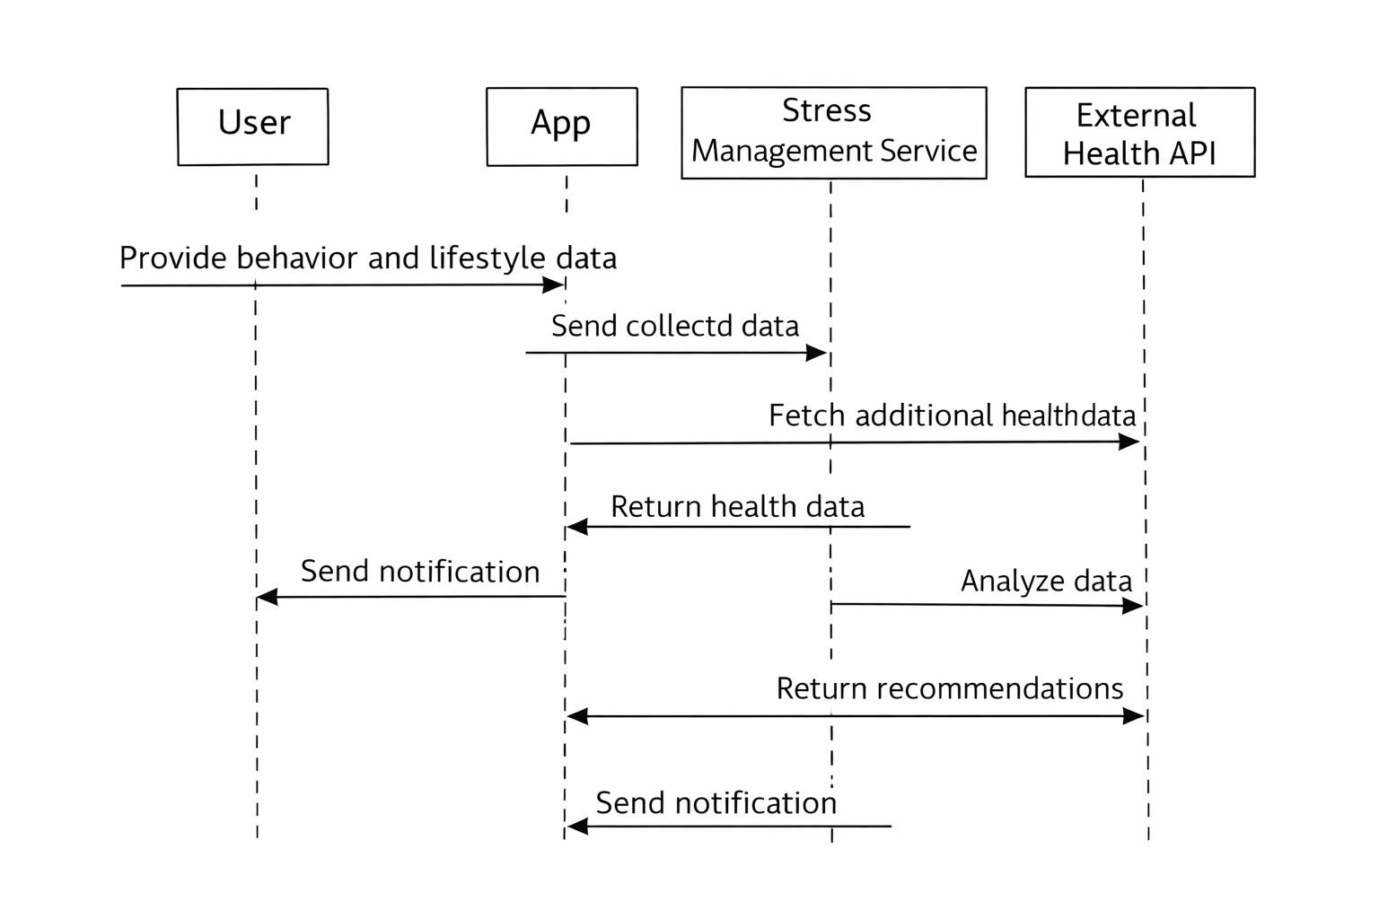
SEQUENCE DIAGRAM
1

Slide 12
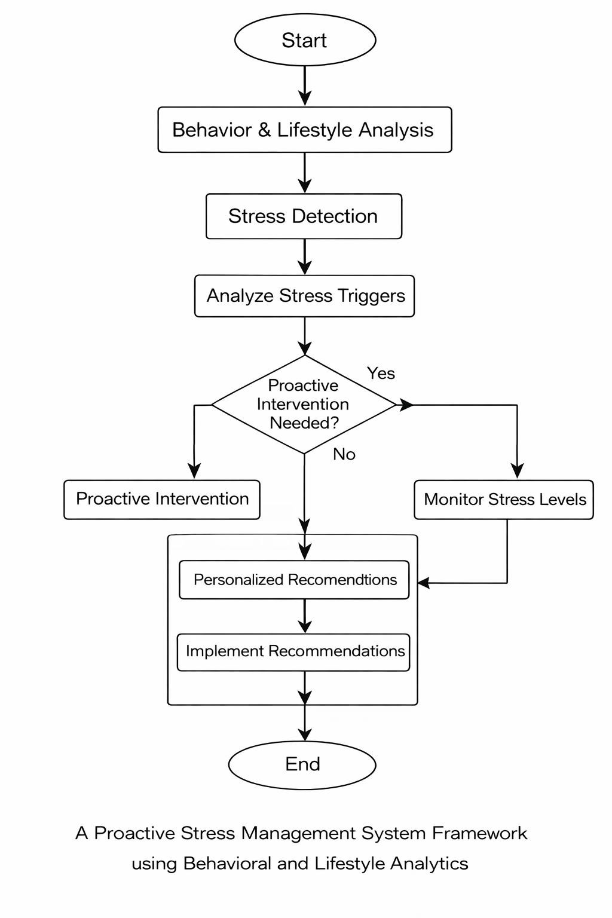
ACTIVITY DIAGRAM
1

Slide 13
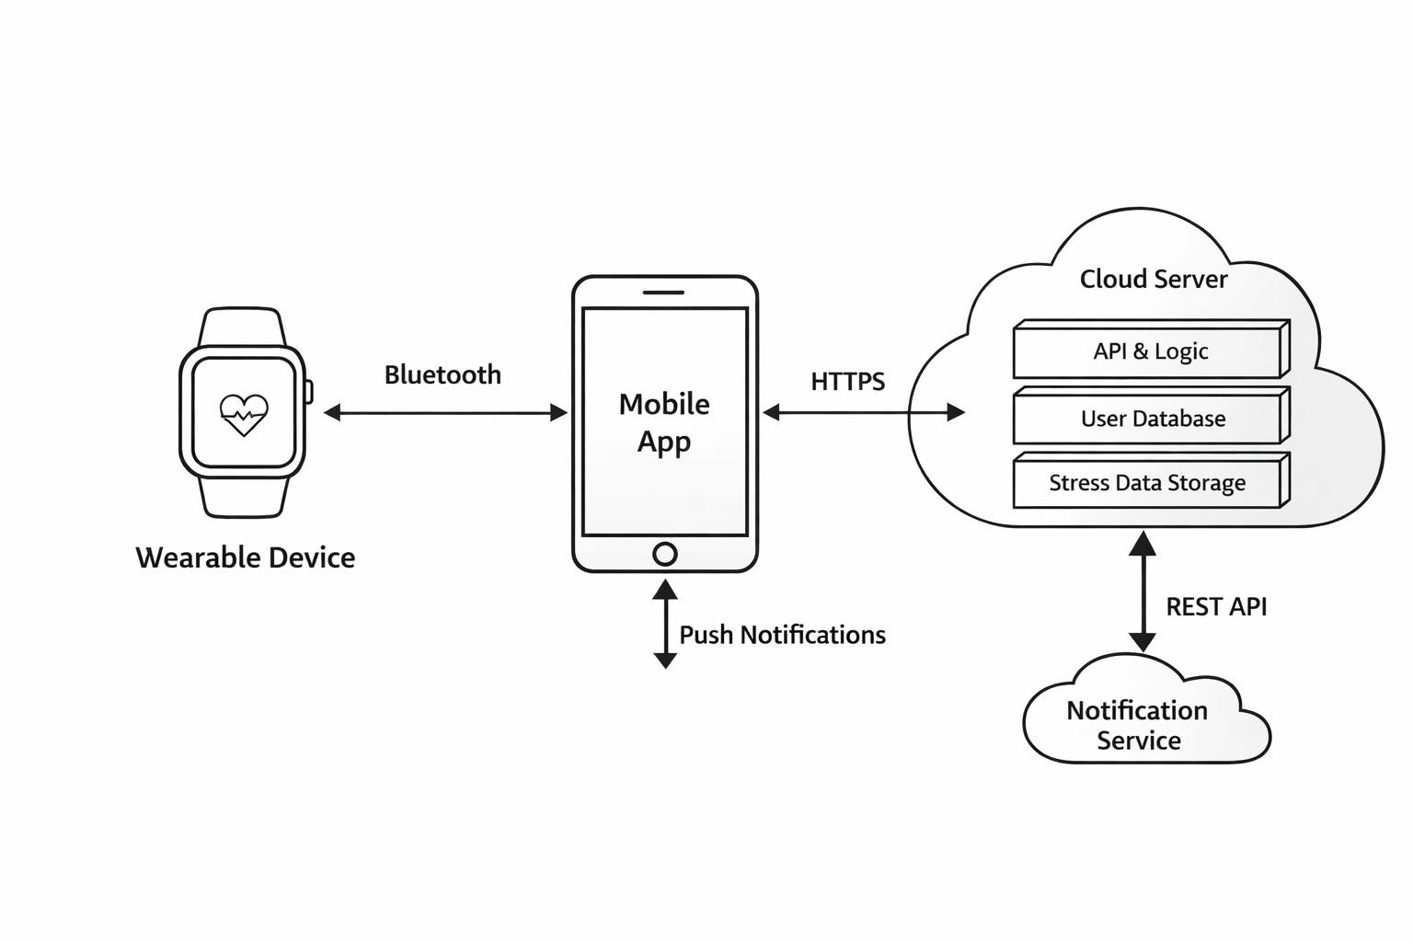
DEPLOYMENT DIAGRAM
1

Slide 14
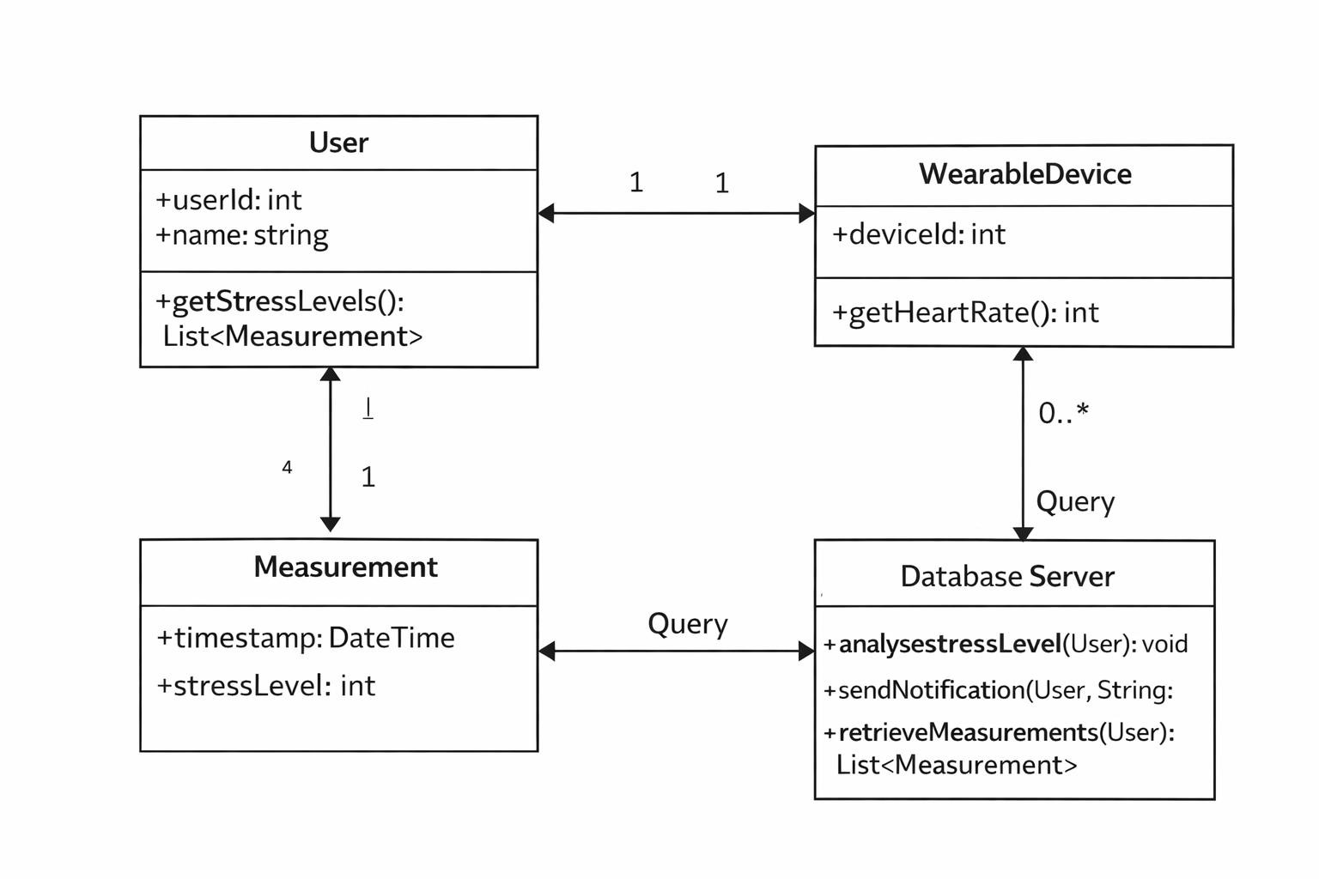
CLASS DIAGRAM
1

Slide 15
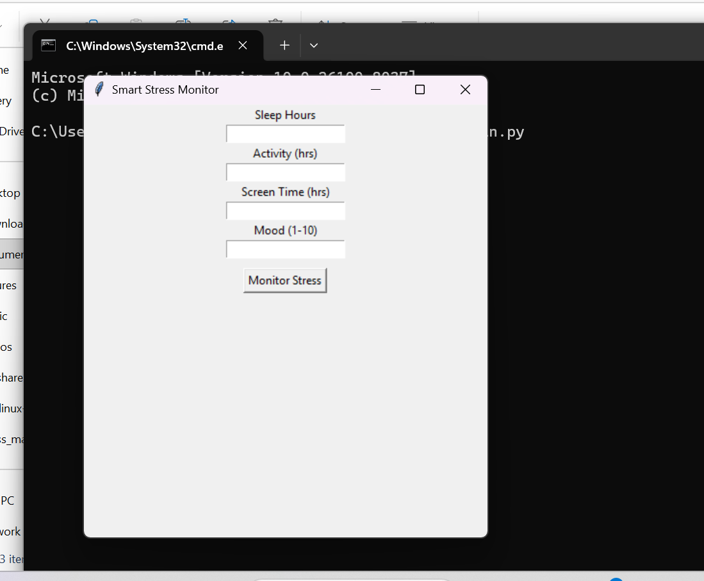
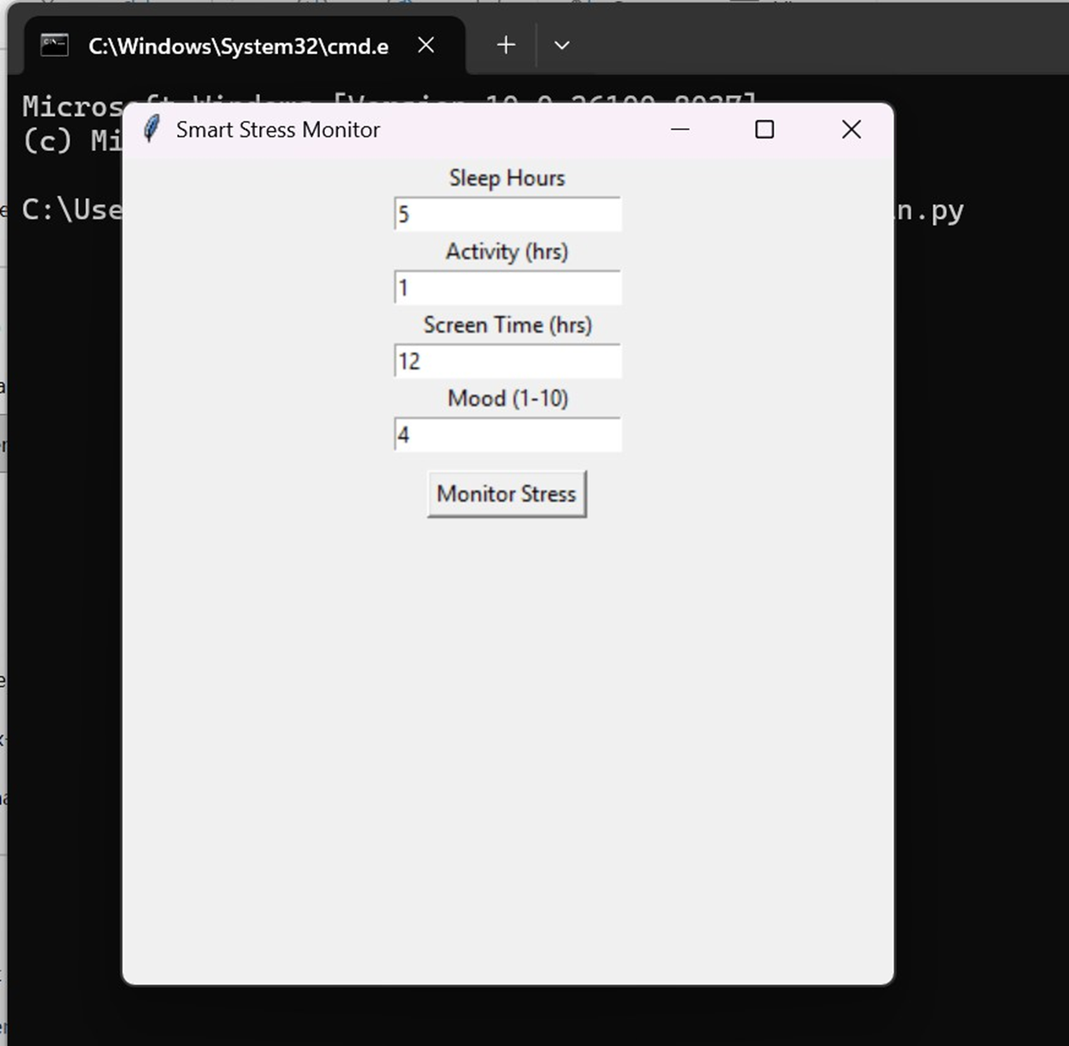
Implementation

Slide 16
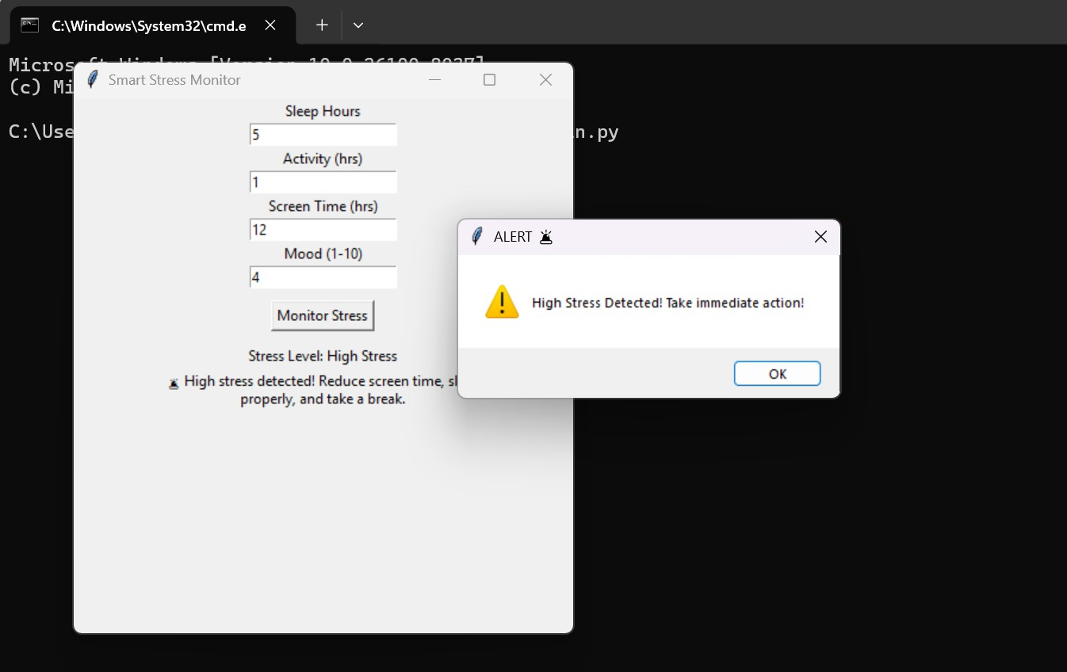
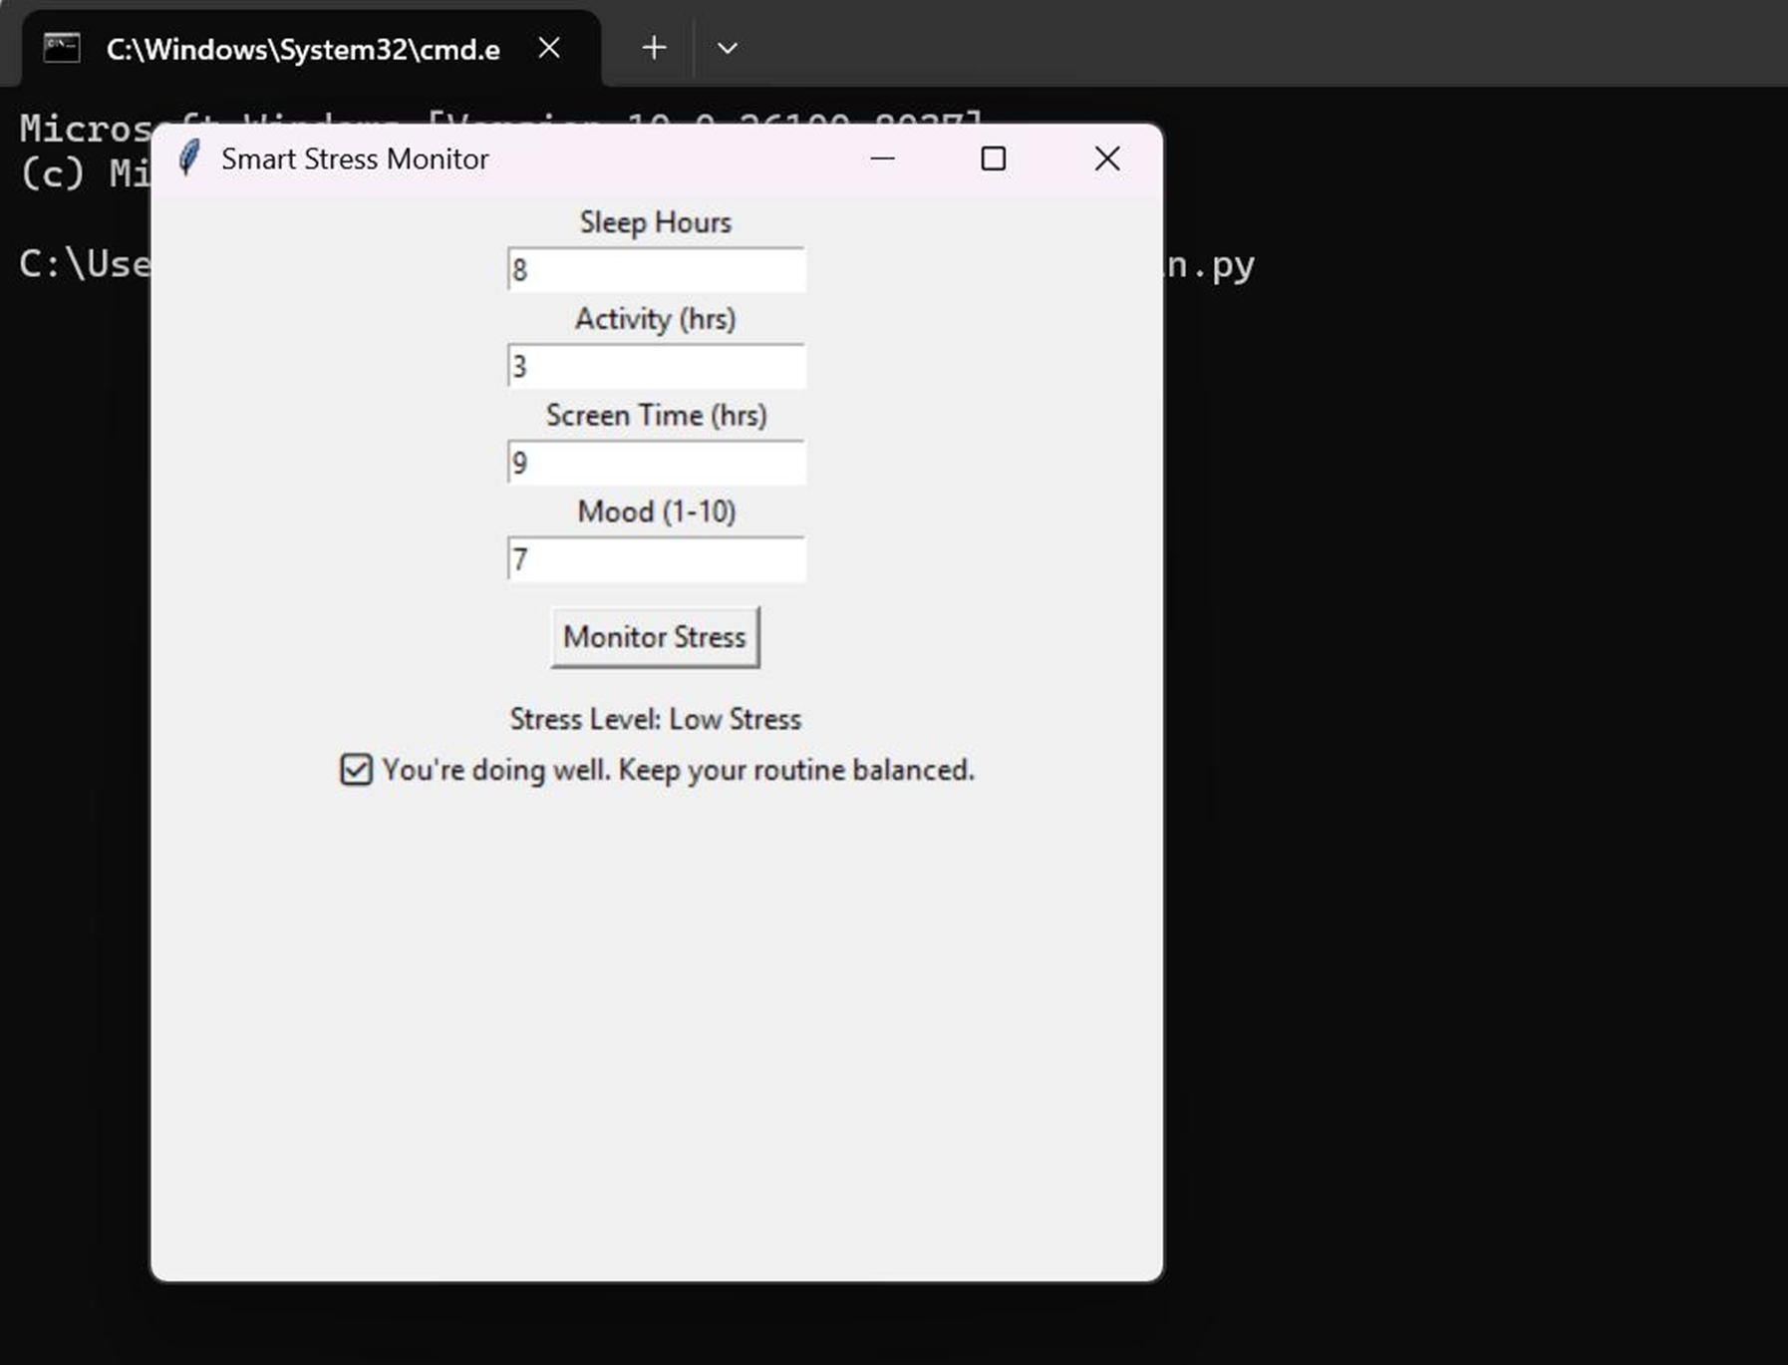

Slide 17
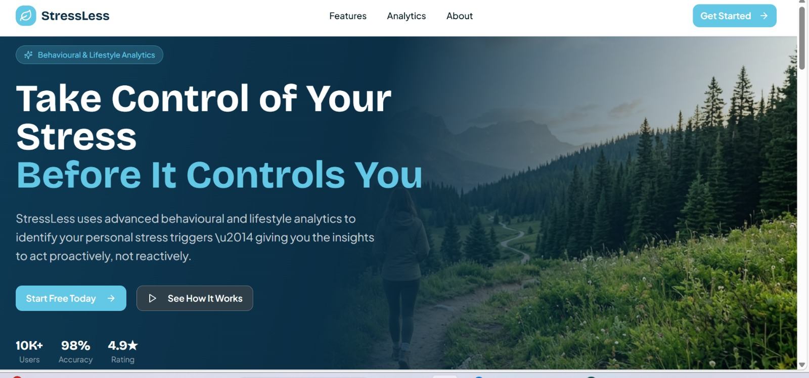
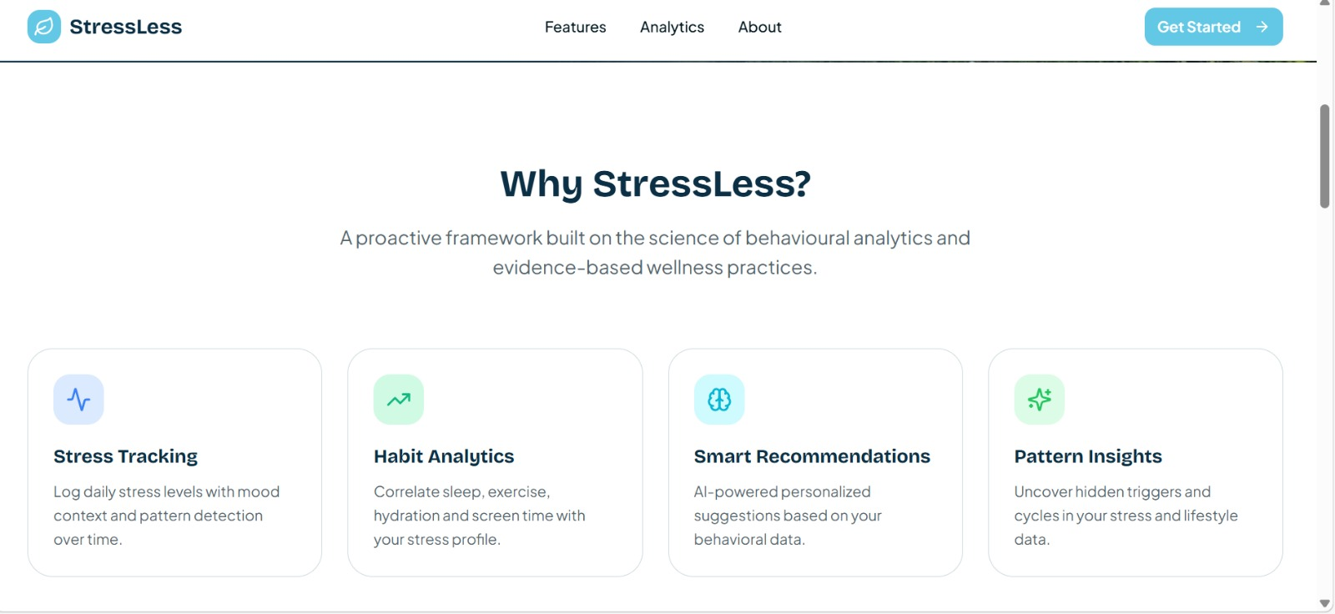

Slide 18
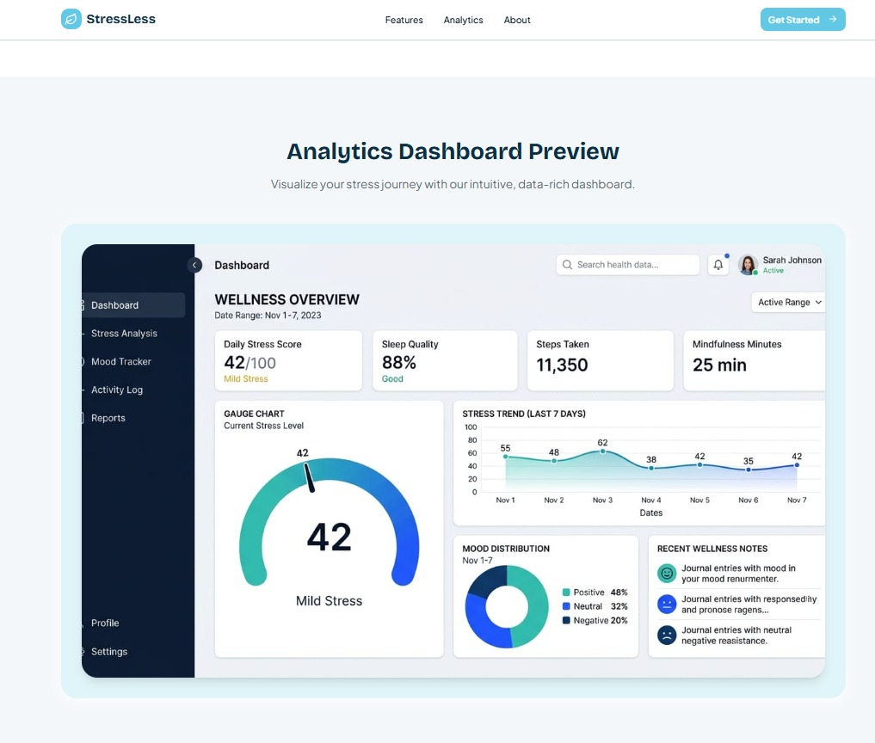
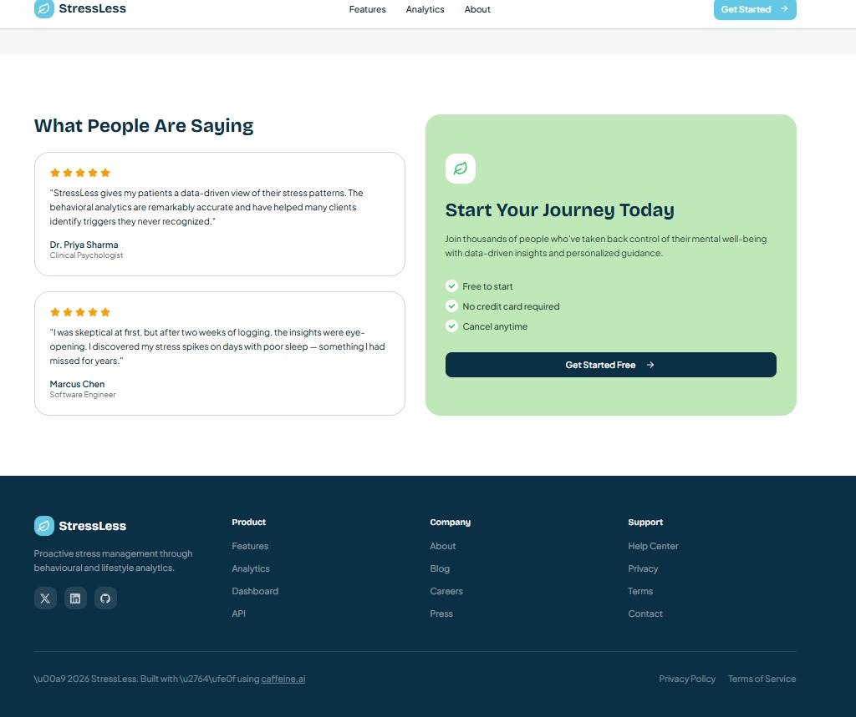

Slide 19
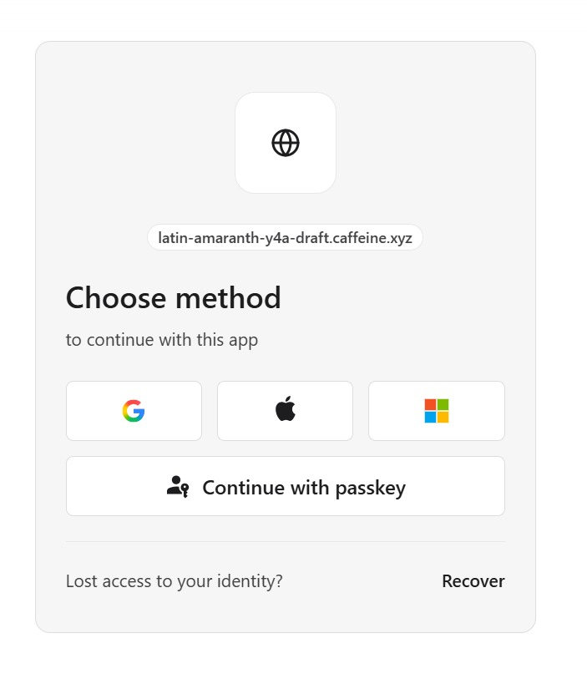
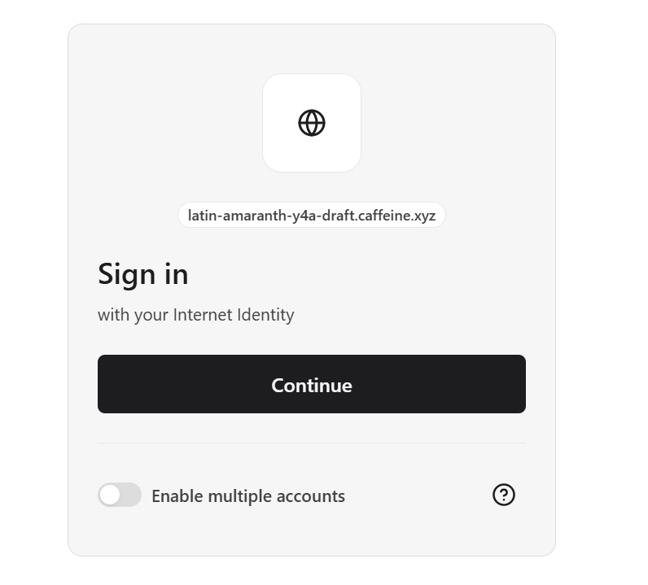

Slide 20
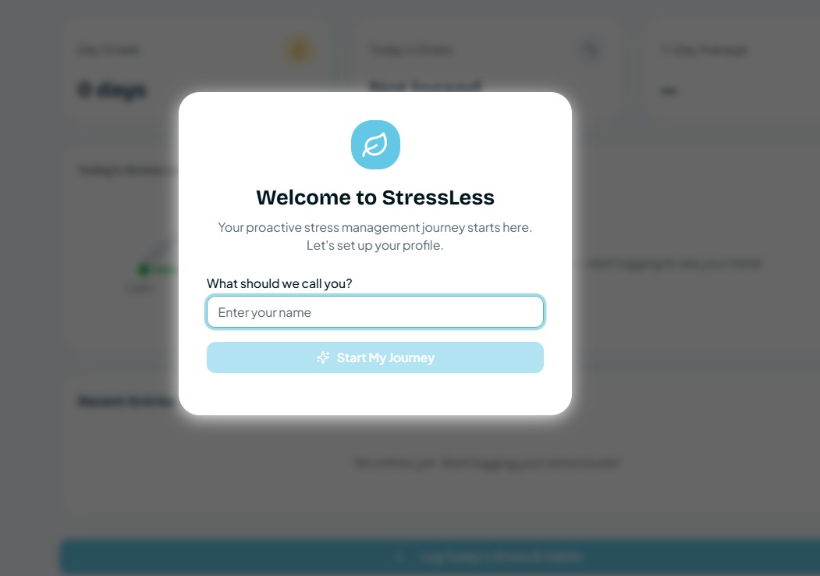
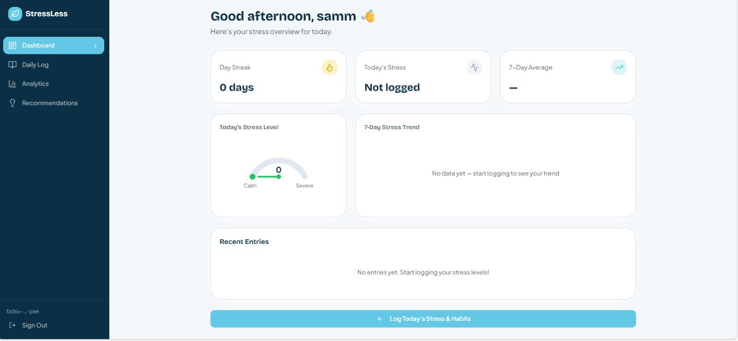

Slide 21
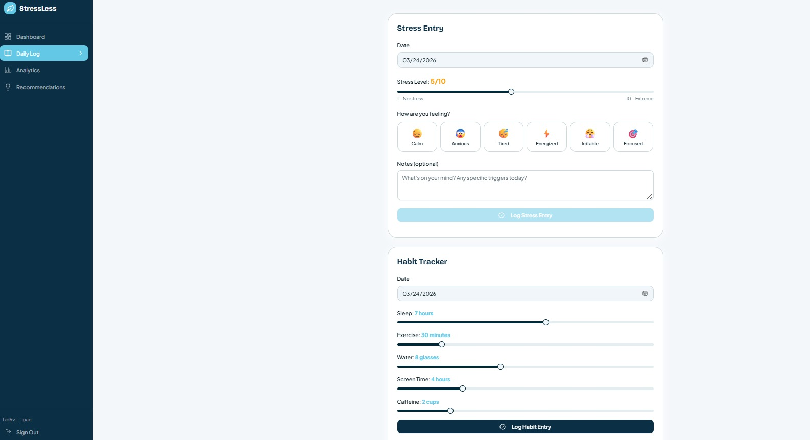
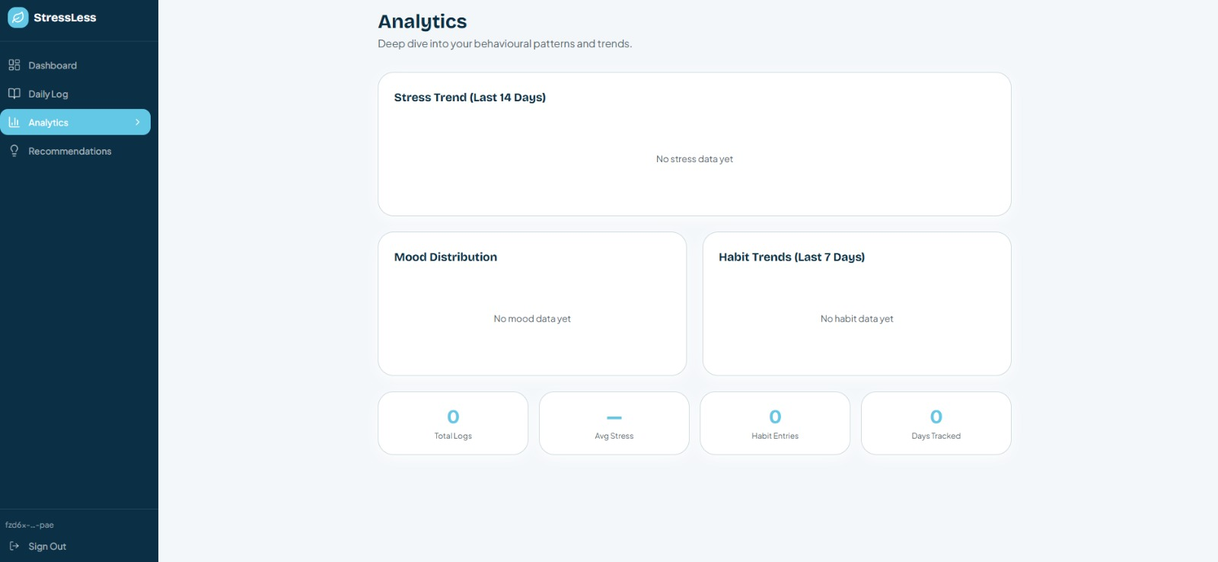

Slide 22
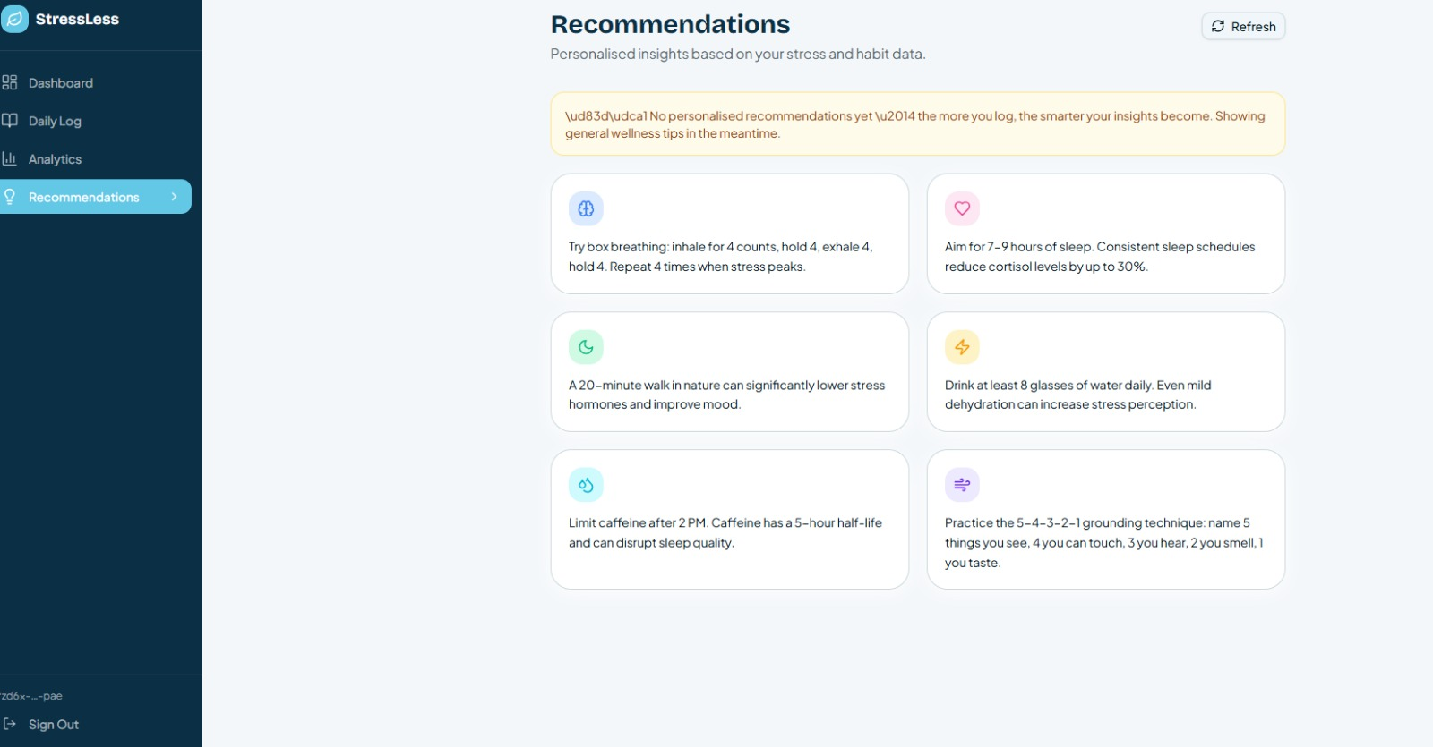

Slide 23
THANK YOU

